Slide 1

Introduction to Computing Memory Architecture Lab.
September 25, 2020
Sungjoo Yoo
Computing Memory Architecture Lab.
CSE, SNU
http://cmalab.snu.ac.kr

Slide 2
Overview
Prof. Sungjoo Yoo, ’00 PhD SNU
  ~’04 TIMA lab, France
  ~’08 S. LSI, Samsung Electronics (involved in 1st SSD product and iPhone AP design)
  ~’15 POSTECH, ~now SNU
Deep learning design optimization: 5 PhD students
  Low rank approximation [ICLR16]
  Quantization [CVPR17][ECCV18][Arxiv18][ECCV20]
  Hardware accelerator [DATE17][D&T18][TCAD18][ISCA18][Microp20][Access20]
  Self-supervised learning for optimizing mobile neural networks
Deep learning application: 2 PhD students
  Recommender system on server and mobile
  3D understanding models for AR/VR devices
Industrial collaboration
  Facebook, Google, Samsung, Hyundai Motors, SK Hynix, SK Telecom, Naver

Slide 3
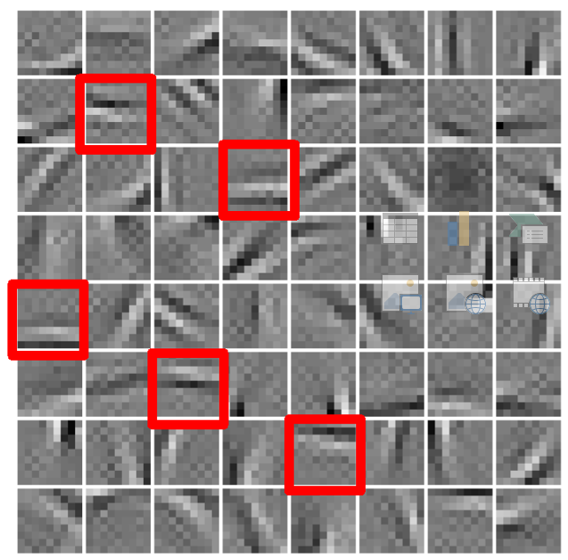
Redundancy in Neural Networks
Pruning
ReLU
AlexNet
Layer | Zero Weight [%] | Zero Activation [%]
conv1 | 15.7 | 0
conv2 | 62.1 | 50.9
conv3 | 65.4 | 76.3
conv4 | 62.8 | 61.8
conv5 | 63.1 | 59.0
Redundant filters [LeCun]
Abundant zero values (in AlexNet)

Slide 4
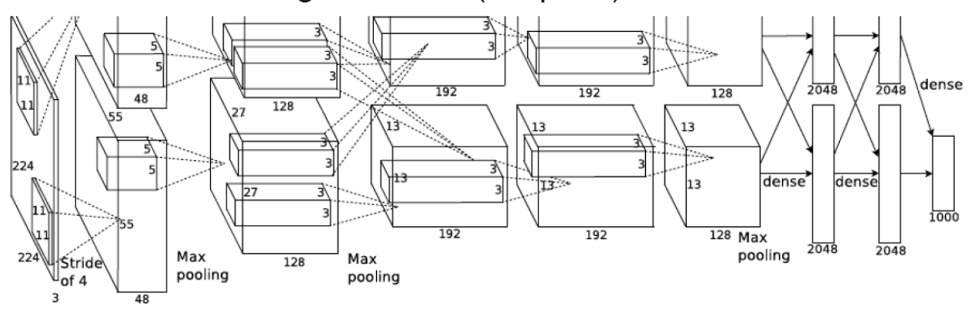
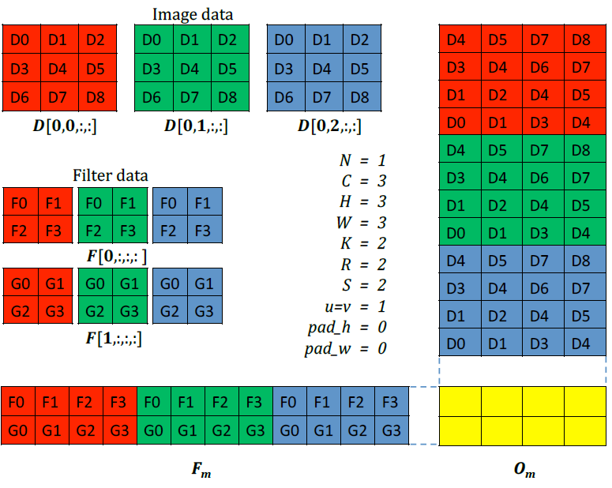
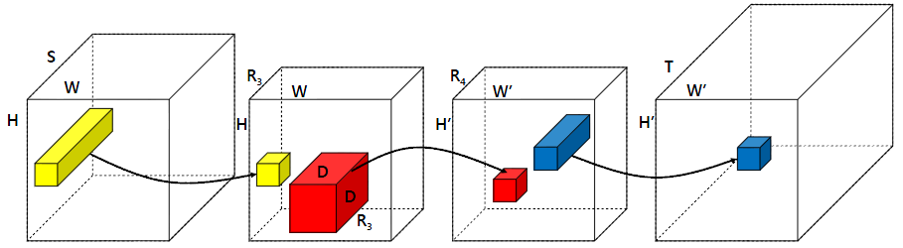
Low-rank Approximation in CNN [ICLR16]
[Kim, ICLR16]
27x27
X
Y
48x5x5
→
25x5x5
48
25
Z
59
Z’
128
55
27
55
27
48x5x5 → 25x5x5
55
55
27
27
U³
C
U⁴
128→ 59

Slide 5
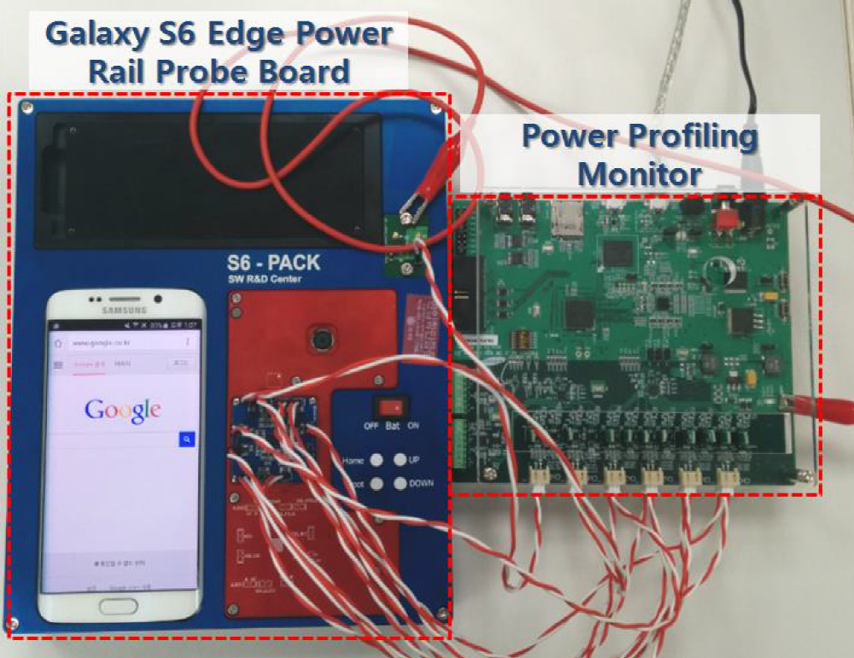
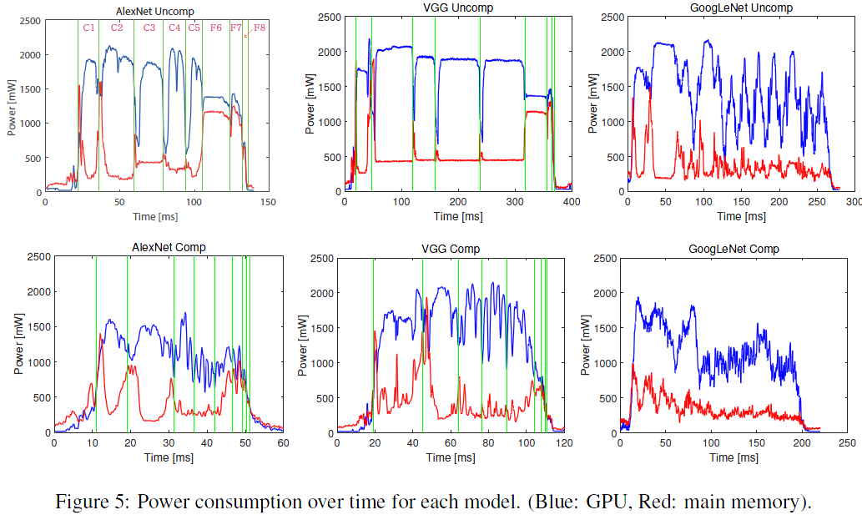
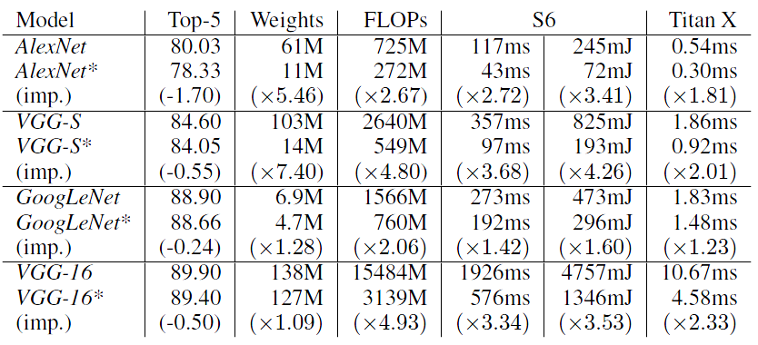
Results on Galaxy S6
[Kim, ICLR16]
Significant reductions in energy consumption and runtime
  Energy: 4.26X~1.6X
  LPDDR4 and Mali GPU
Galaxy S6 results
3.41X
4.26X
1.6X

Slide 6










Skipping Zero Values in Both Weight and Act
[Kim, D&T18]
PE 0
Proportional to intersection of non-zero inputs
$$K_{0}$$
*
$$Total time$$
$$A_{0}$$
Proposed Architecture
$$P_{0}$$
Broadcast
Zero bit-vectors
$$P_{1}$$
Zero-induced load imbalance
$$A_{0}$$
$$Total time$$
PE 1
$$K_{1}$$
Cambricon-X
$$P_{0}$$
*
$$A_{0}$$
$$P_{1}$$
K: kernel weights
Zero bit-vectors
$$Total time$$
A: input activations
Cnvlutin
$$P_{0}$$
P: partial sums
$$P_{1}$$

Slide 7
4X~5X Speedup in AlexNet and VGG-16
[Kim, D&T18]
5.2x
4x
AlexNet
4x (AlexNet) and 5.2x (VGG-16) speed up w.r.t. Eyeriss
1.8x (AlexNet) and 2.1x (VGG-16) speed up w.r.t. AZ (Cnvlutin)
19.6% (AlexNet) and 25.8% (VGG-16) speed up w.r.t. WAZ
Notes:
완성

Slide 8
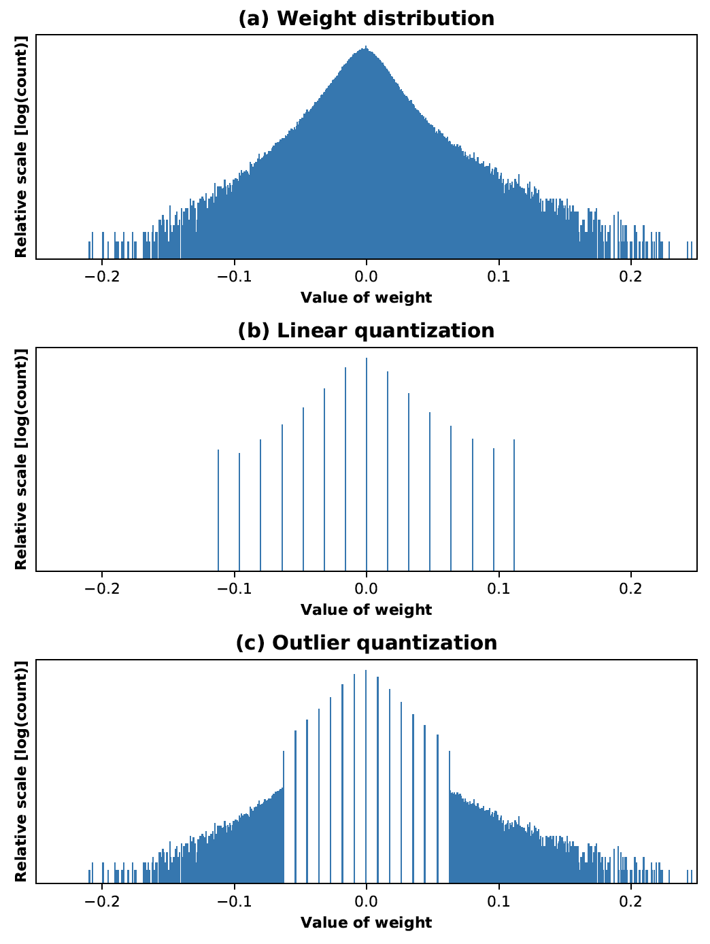
Outlier-aware Quantization (OLQuant)
Observation
  Reduced precision suffers from quantization error mainly due to outliers
Proposed idea
  Handle outliers (e.g., 1~3% of total data) separately from the other data
Smaller quantization error for all the data
  Outlier → high precision, e.g., 16 bits, at no quantization error
  Majority of data → reduced precision with narrower region, i.e., smaller quantization error
Weights in 2nd CONV of AlexNet

Slide 9
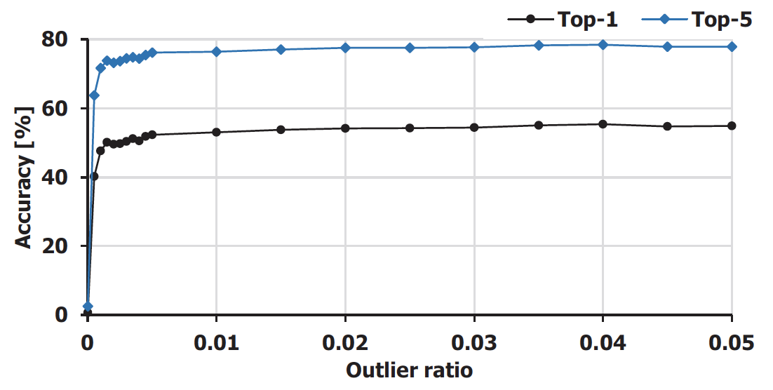
Feasibility Test: AlexNet
4-bit quantization with outliers of 0.5% already gives good accuracy
Outliers of 3.5% lose only <1% accuracy
Weights in 2nd CONV of AlexNet

Slide 10
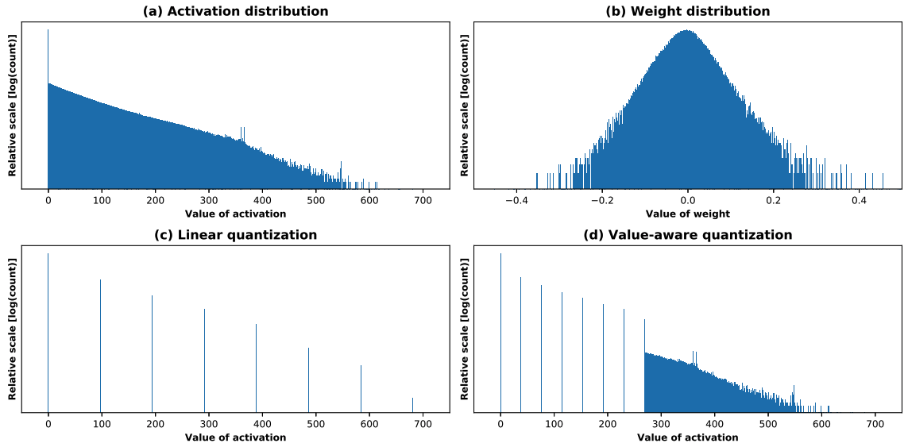
OLQuant Reduces Memory Cost in Training
[Park, ECCV18]
9X reduction in stored activations for ResNet-50 training
  3 bits (98%) and 32 bits (2%) for activations
3 bits (98%)
32 bits (2%)

Slide 11
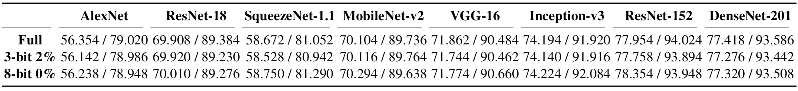
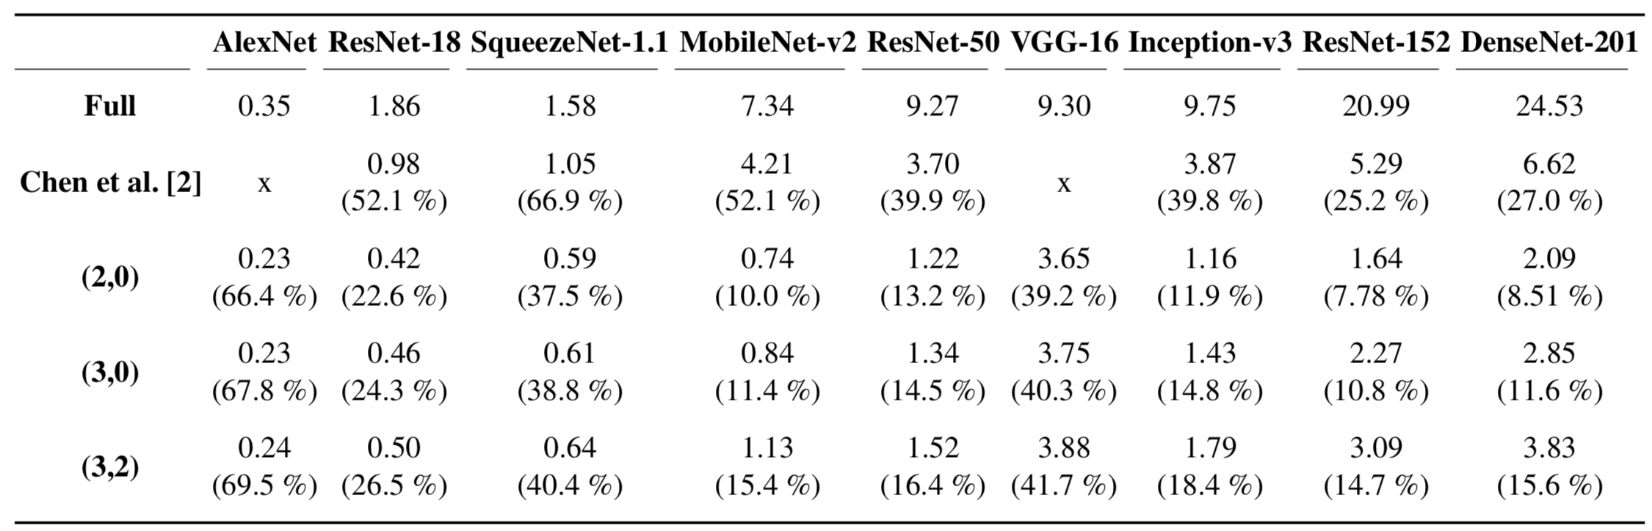
Results: Memory Cost Reduction in Training with Full-Precision Training Accuracy
[Park, ECCV18]

Slide 12
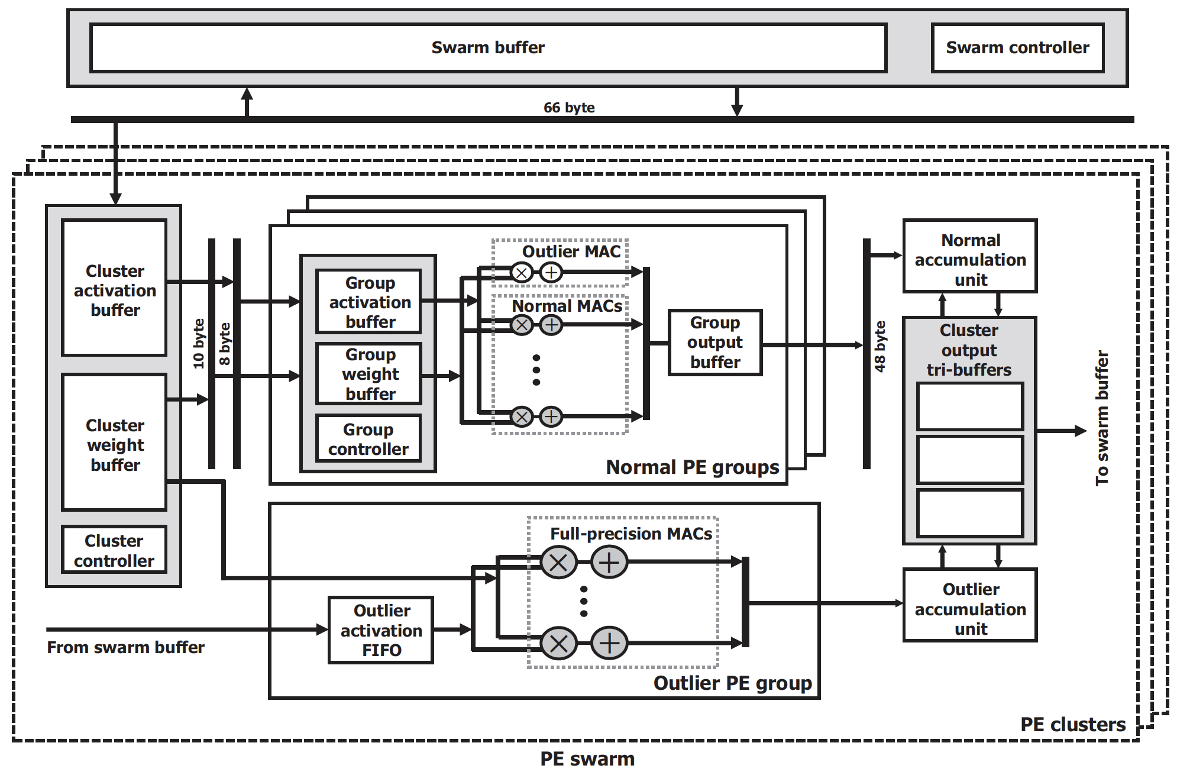
OLAccel: 4-bit Hardware Accelerator for Outlier-aware Quantization
[Park, ISCA18]
Basically, 4-bit computation
Consists of PE groups
Each PE group has 16-way SIMD lanes

Slide 13
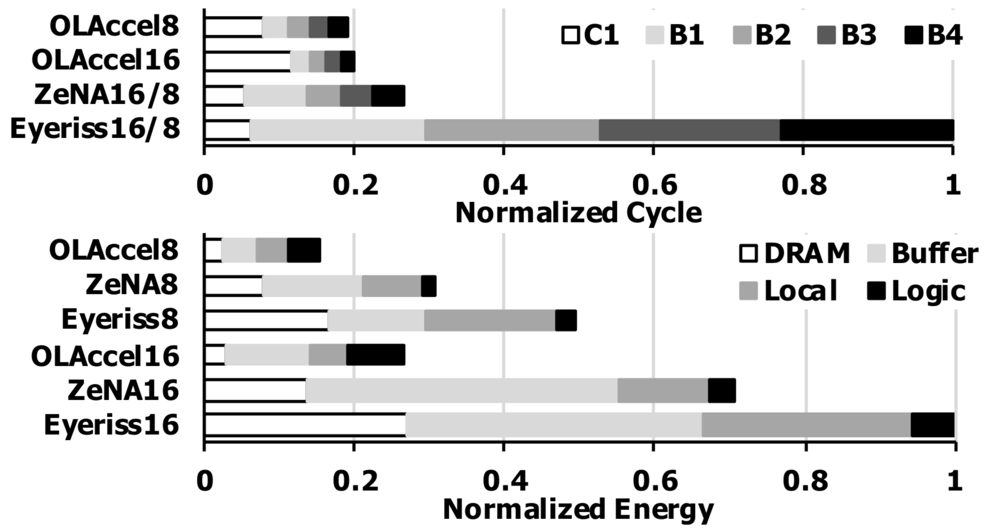
ResNet-18 without Fine-tuning
[Park, ISCA18]
Pruned model
8-bit OLAccel vs. ZeNA8
  OLAccel8 gives 29.0% and 49.5% reduction in cycle and energy
16-bit OLAccel vs. ZeNA16
  OLAccel16 gives 25.3% (cycle) and 62.2% (energy) reduction
29.0%
25.3%
49.5%
62.2%

Slide 14
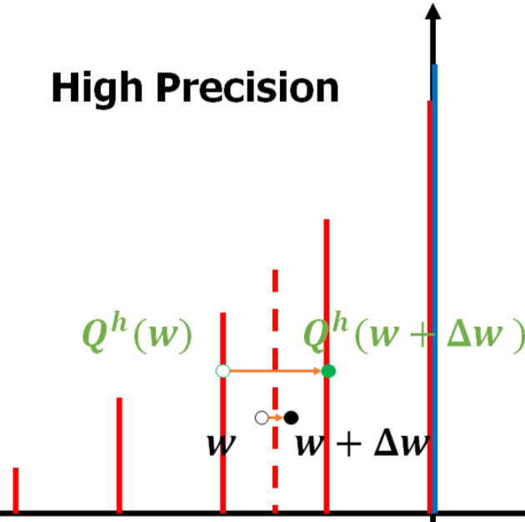
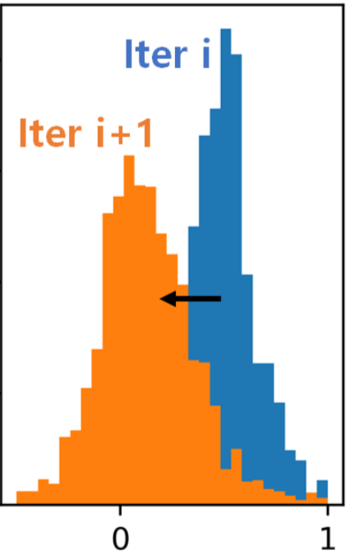
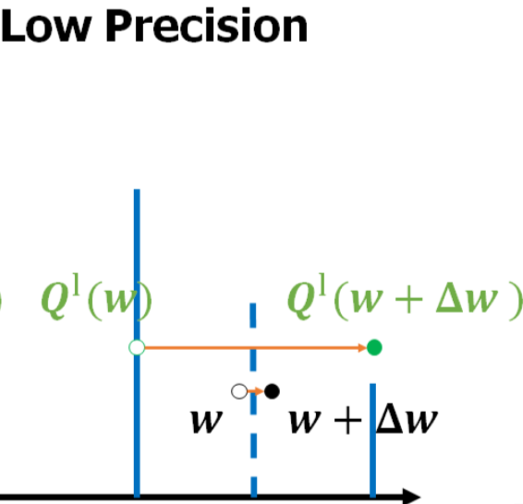
Activation Instability due to Weight Quantization (AIWQ)
In low precision, the same Δw can have larger impact on the activation output, which can make output activation distributions significantly change after weight update

Slide 15
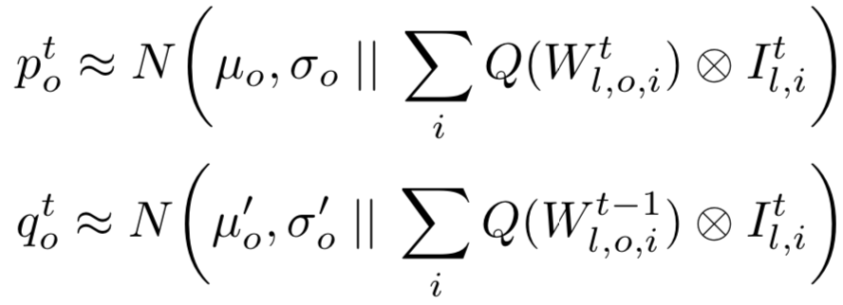

AIWQ Metric based on KL Divergence
[Park, ECCV20]
Normal distribution (i.e., 2nd order) model of per-channel output activation before (q^{t}) and after (p^{t}) batch t
AIWQ = Per-layer expectation of channel-level KL divergence between two distributions p and q
q
Before weight update, i.e.,
weights in iteration t-1
p
After weight update
in iteration t
channel level
layer level instability

Slide 16
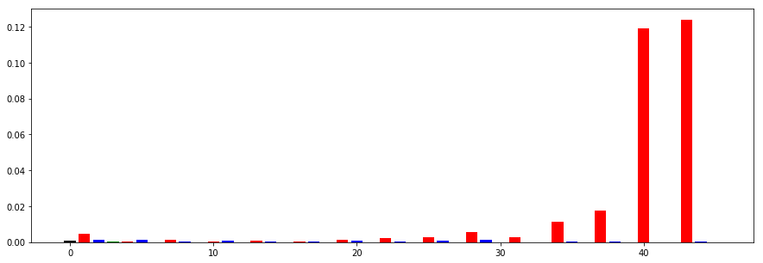
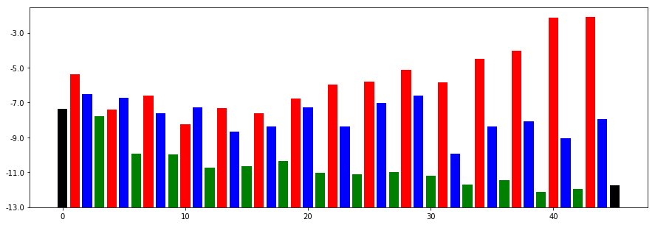


Incremental Freezing of CONV Weights while Continue to Train the Others
[Park, ECCV20]
Freeze the weights of 1/3 of the entire layers (having large AIWQ) and train the other CONV weights and BN layers
Freeze the weights of another 1/3 layers and train the other CONV weights and BN layers
Freeze the remaining 1/3 layers (i.e., all CONV weights) and train BN layers
Depthwise
$$KL distance$$
Reduction
Expansion
Freeze 1/3
$$log⁡(KL)$$
Freeze 1/3
Freeze 1/3

Slide 17
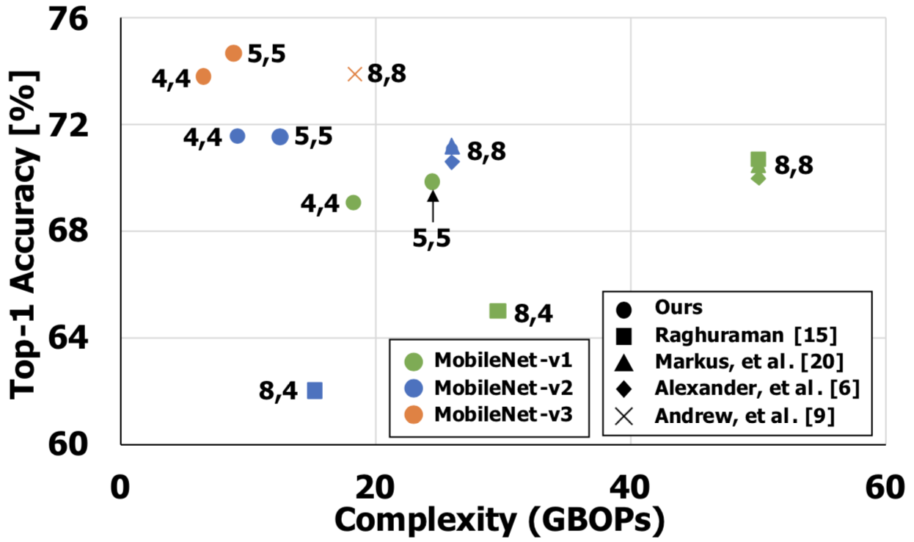
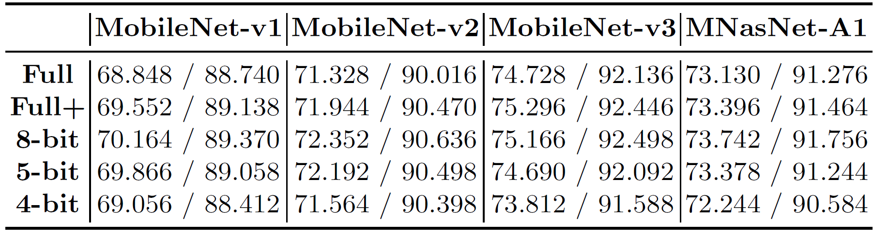
ImageNet Experiments
[Park, 2020]
Linear quantization of activations/weights on all layers
  including first/last layers
4-bit quantization gives 1.5% top-1 accuracy loss in MobileNet-v3
  8 bits for input pixel data and activation of squeeze-and-excitation
-0.496 %
-0.380 %
-1.484 %

Slide 18
Overview
Prof. Sungjoo Yoo, ’00 PhD SNU
  ~’04 TIMA lab, France
  ~’08 S. LSI, Samsung Electronics (involved in 1st SSD product and iPhone AP design)
  ~’15 POSTECH, ~now SNU
Deep learning design optimization: 5 PhD students
  Low rank approximation [ICLR16]
  Quantization [CVPR17][ECCV18][Arxiv18][ECCV20]
  Hardware accelerator [DATE17][D&T18][TCAD18][ISCA18][Microp20][Access20]
  Self-supervised learning for optimizing mobile neural networks
Deep learning application: 2 PhD students
  Recommender system on server and mobile
  3D understanding models for AR/VR devices
Industrial collaboration
  Facebook, Google, Samsung, Hyundai Motors, SK Hynix, SK Telecom, Naver

Slide 19
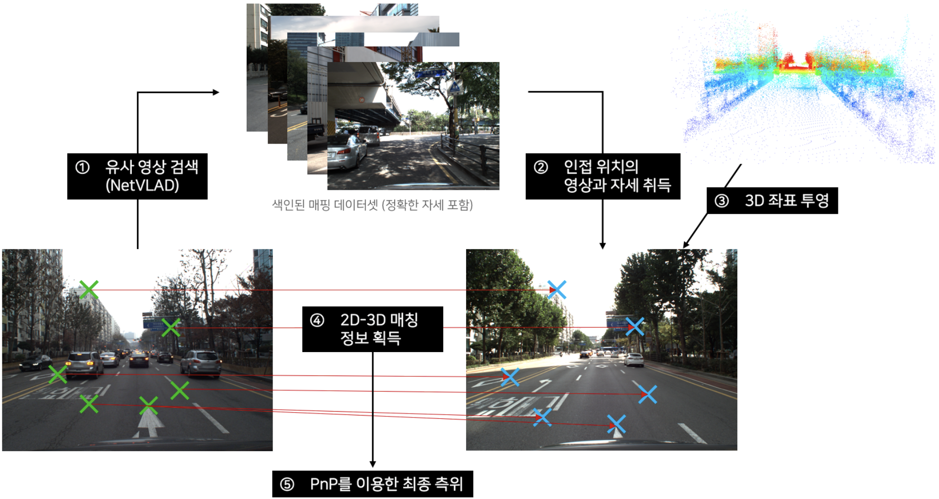
Visual Localization: Image Retrieval and Pose Estimation (Naver Labs)
https://www.naverlabs.com/storyDetail/173
https://www.naverlabs.com/storyDetail/161

Slide 20
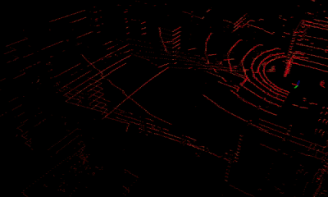
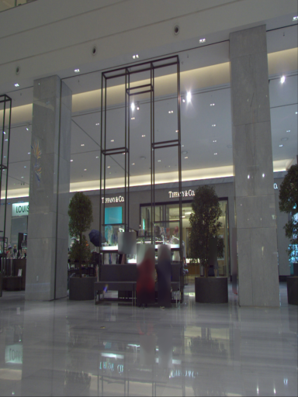
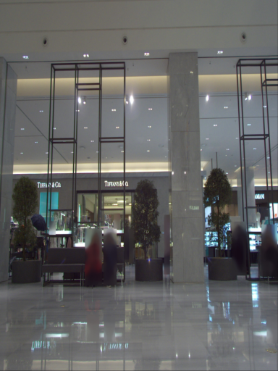
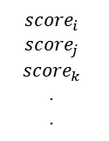



Naver Labs Localization & Mapping Challenge
2020/4-8
https://www.naverlabs.com/storyDetail/161
Indoor dataset: Pangyo Hyundai department (B1, F1)
Outdoor dataset: Pangyo and Youido
Image Retrieval
ㅇ
DB cluster
Database
Global
Descriptor
Query
Pose Estimation
Lidar Projection & 2D-3D matching
ㅇ
Feature Matching & Re-ranking
$$R, T$$
ㅇ
$$X$$
$$score_{i}$$
$$score_{j}$$
$$score_{k}$$
.
.
$$x$$

Slide 21
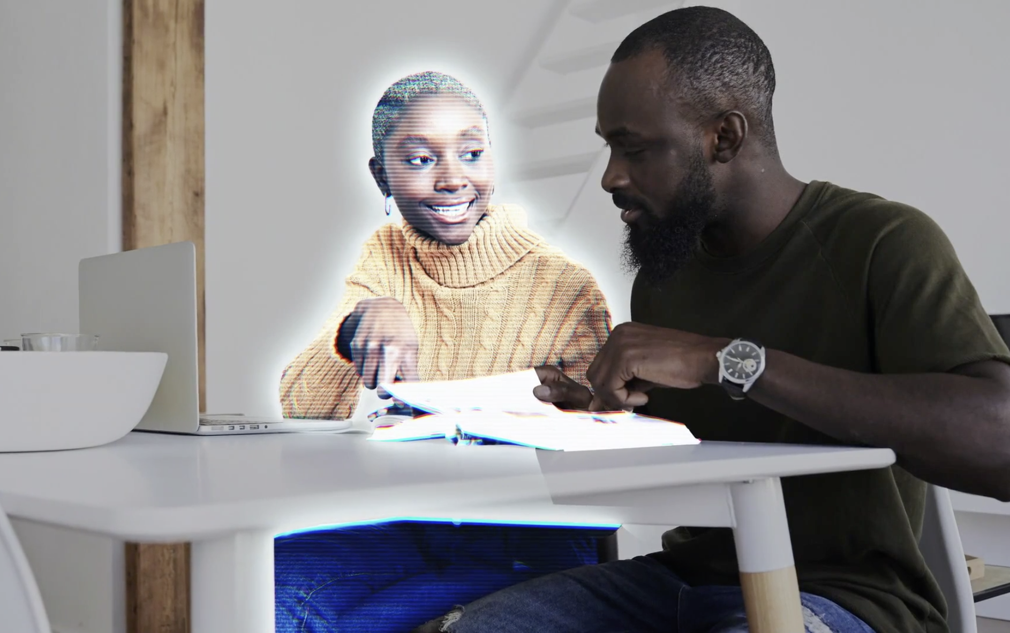
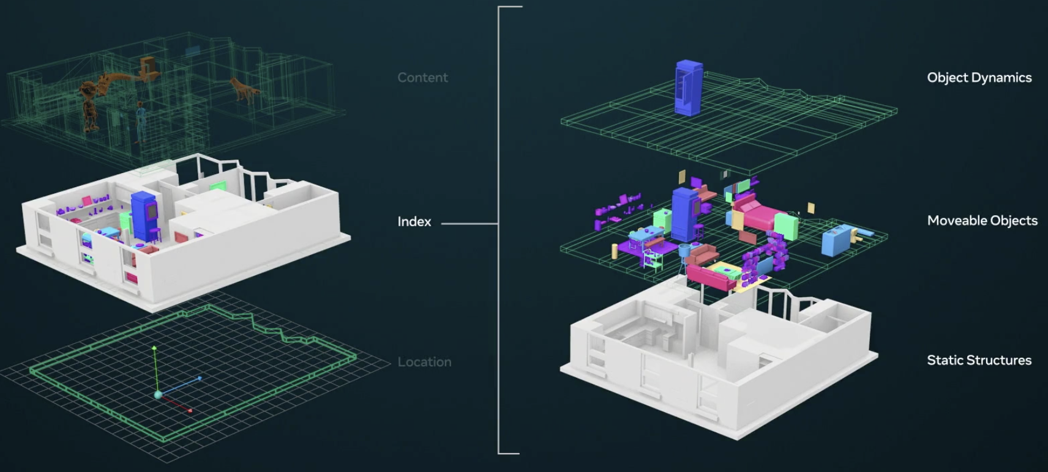
Related Work:
Facebook’s Live Map
https://www.facebook.com/facebookrealitylabs/videos/357103208754306
Live map consists of 3 layers
  Content, index and location
It allows an avatar to be placed in our world (in AR/VR) in a natural way
It also helps mobile AR/VR devices save energy since those devices do not need to sense everything around us every time
Instead, they can focus on dynamic differences from the live map, which reduces computation cost

Slide 22
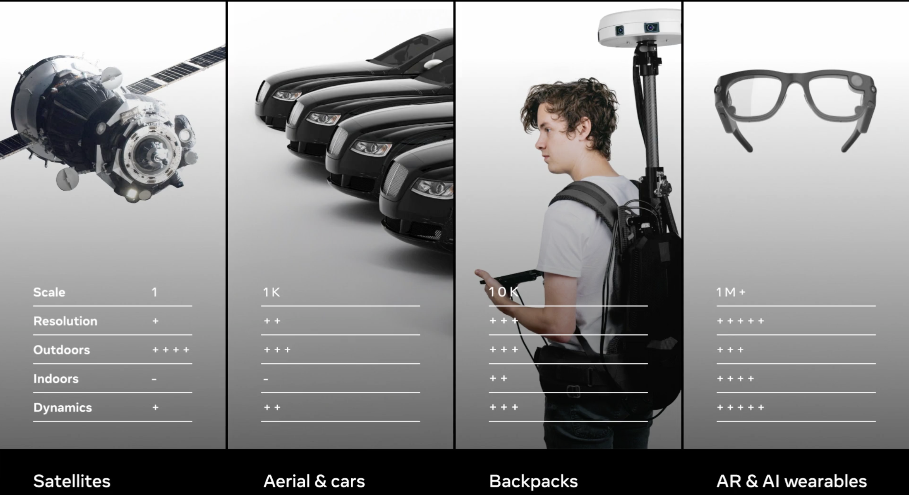
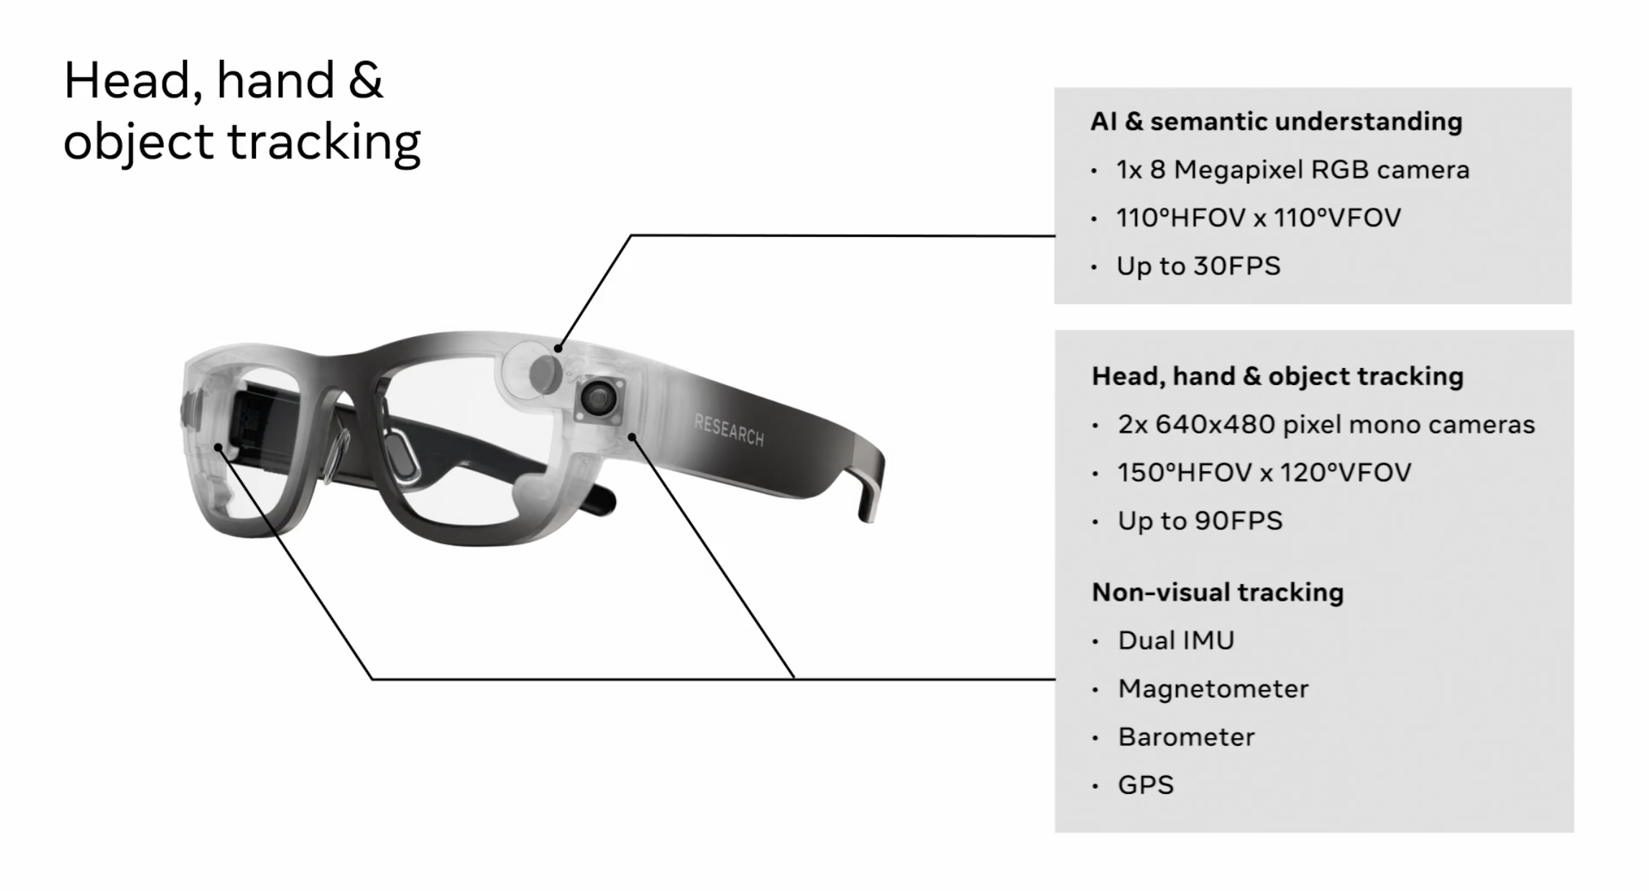
Related Work: Facebook’s Project Aria
https://www.facebook.com/facebookrealitylabs/videos/357103208754306
Especially, wearable devices will offer ego-centric view
In Project Aria, they use smart glasses, a research prototype, to collect ego-centric data

Slide 23
Research Plan
Towards Powerful Mobile AR/VR Devices
“Need 10X~100X energy efficiency improvements and Privacy”
  Vikas Chandra, Facebook Reality Lab. (HENP 2020 Workshop)
Algorithm optimization
  On-device self-supervised learning
  Exploiting multi-modality, e.g., depth sensor, image, voice, motion, …
Compiler-level optimization
  AutoML for binary neural network
  Low-precision on-device training
Hardware optimization
  Efficient accelerator for binary neural networks and training/programmability
  In-memory computation for conditional execution of extremely large binary neural network

Slide 24
Thank You!
sungjoo.yoo@gmail.com

